Slide 1
Aktau city
“Gymnasium 13”
August Pedagogical Conference
Report
“ How to create and conduct a formative and summative assessment with GoFormative? “
prepared by
Teacher of English Uralbayeva Akmaral
Academic year 2020-2021

Slide 2
Aim
Organization of Summative Assessment tasks using GoFormative platform in the context of distance learning

Slide 3

Distance learning, also called distance education, e-learning, and online learning, form of education in which the main elements include physical separation of teachers and students during instruction and the use of various technologies to facilitate student-teacher and student-student communication.

Slide 4
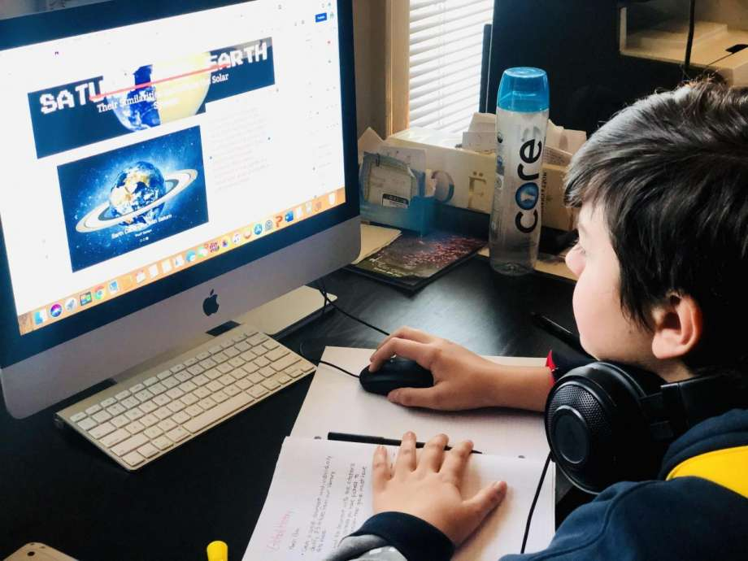
This is the essential and effective learning system that we strive for.

Slide 5


Slide 6

USING TECHNOLOGIES FOR FORMATIVE AND SUMMATIVE ASSESSMENTS
There are lots of web services for schools that aims to simplify creating, distributing, and grading assignments.
Google Classroom, Classtime, Learning Apps, Google Forms, MS Forms, MS Teams or e-mails, Skype and WhatsApp.

Slide 7
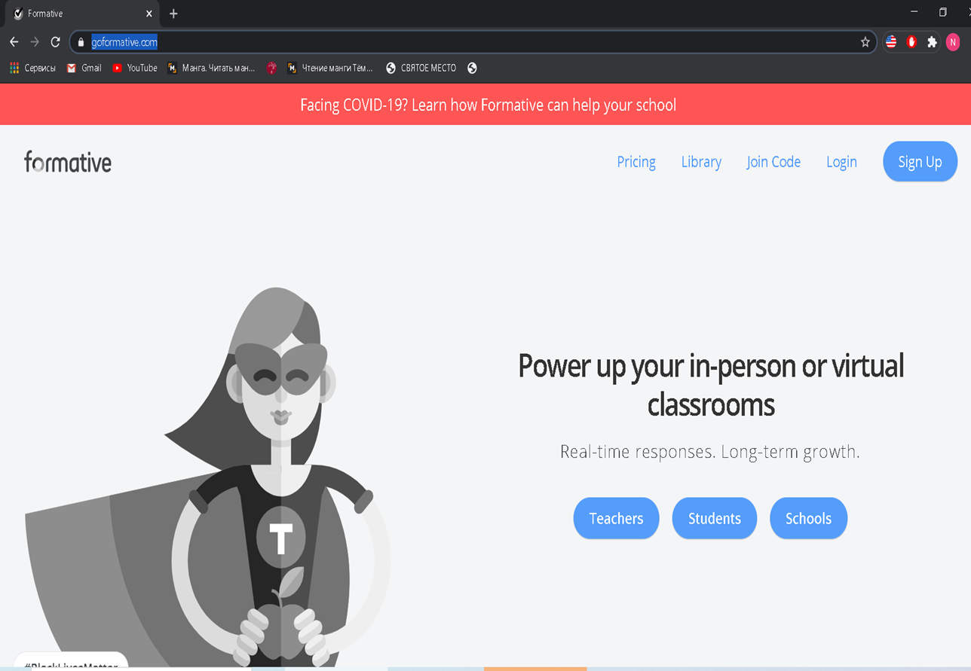


Formative, which is also known as GoFormative, is a web-based tool that allows teachers to create digital formative assessments, tasks, or assignments that are easily accessible from any electronic device: laptop, tablet, or smartphone.

Slide 8
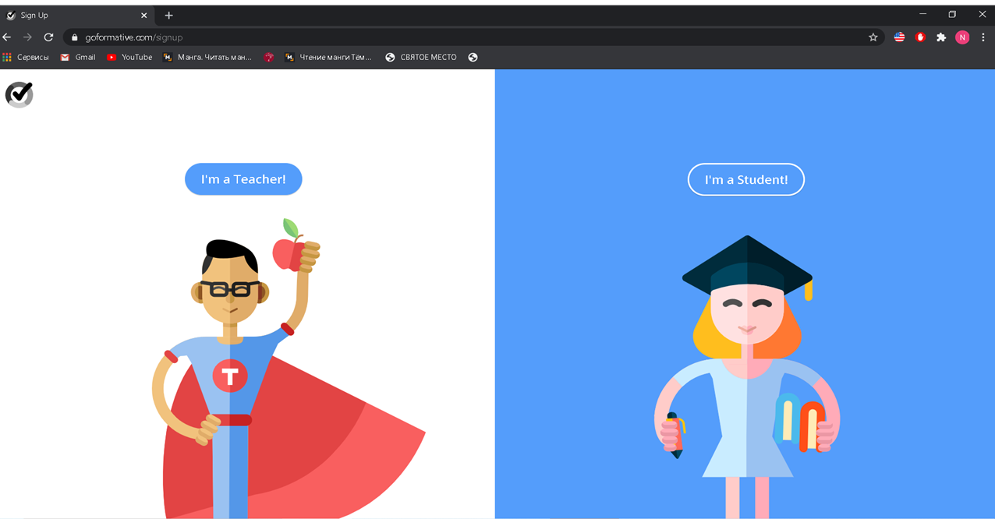

Formative is a web-based tool that allows teachers to create assignments, deliver them to students, receive results, and provide individualized feedback in real-time. Accounts are free for teachers and students. APPROACH. Teachers can set up new accounts through a link on the company website.

Slide 9
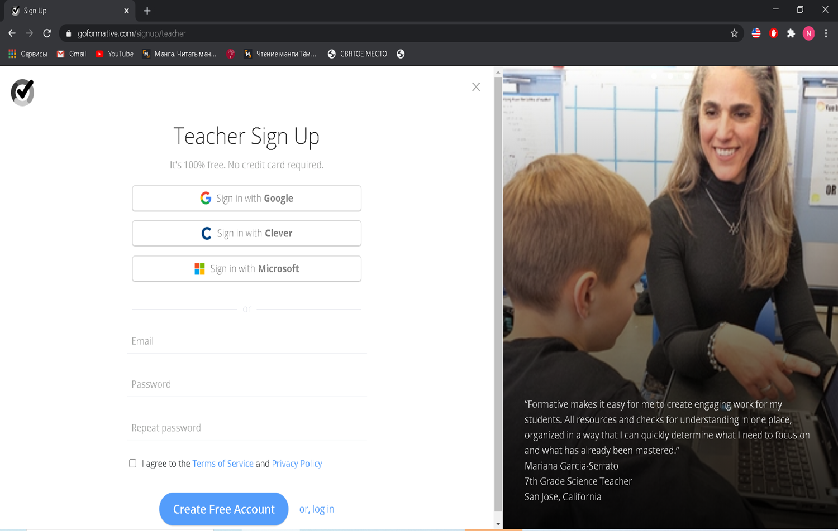



Slide 10
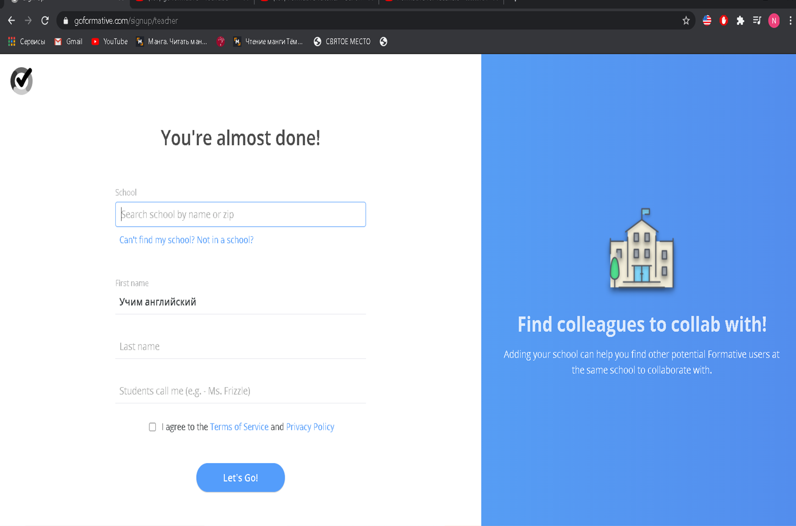


Slide 11
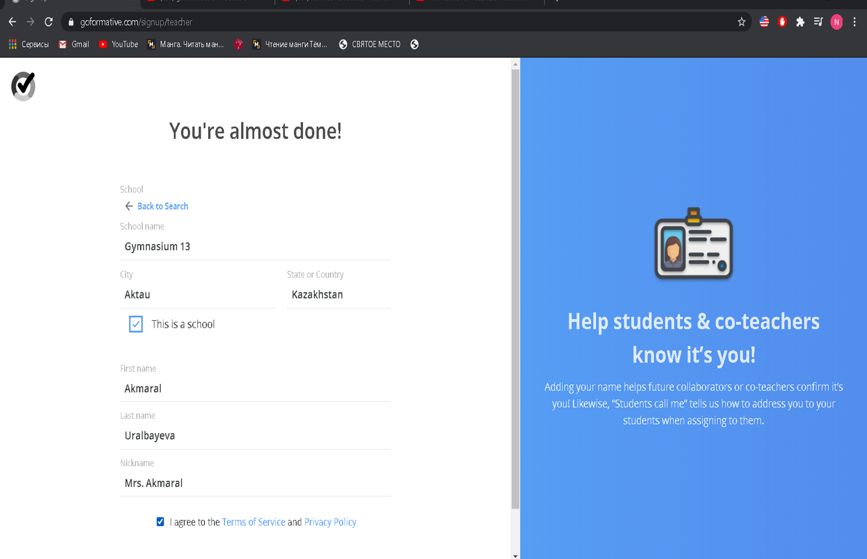


Slide 12
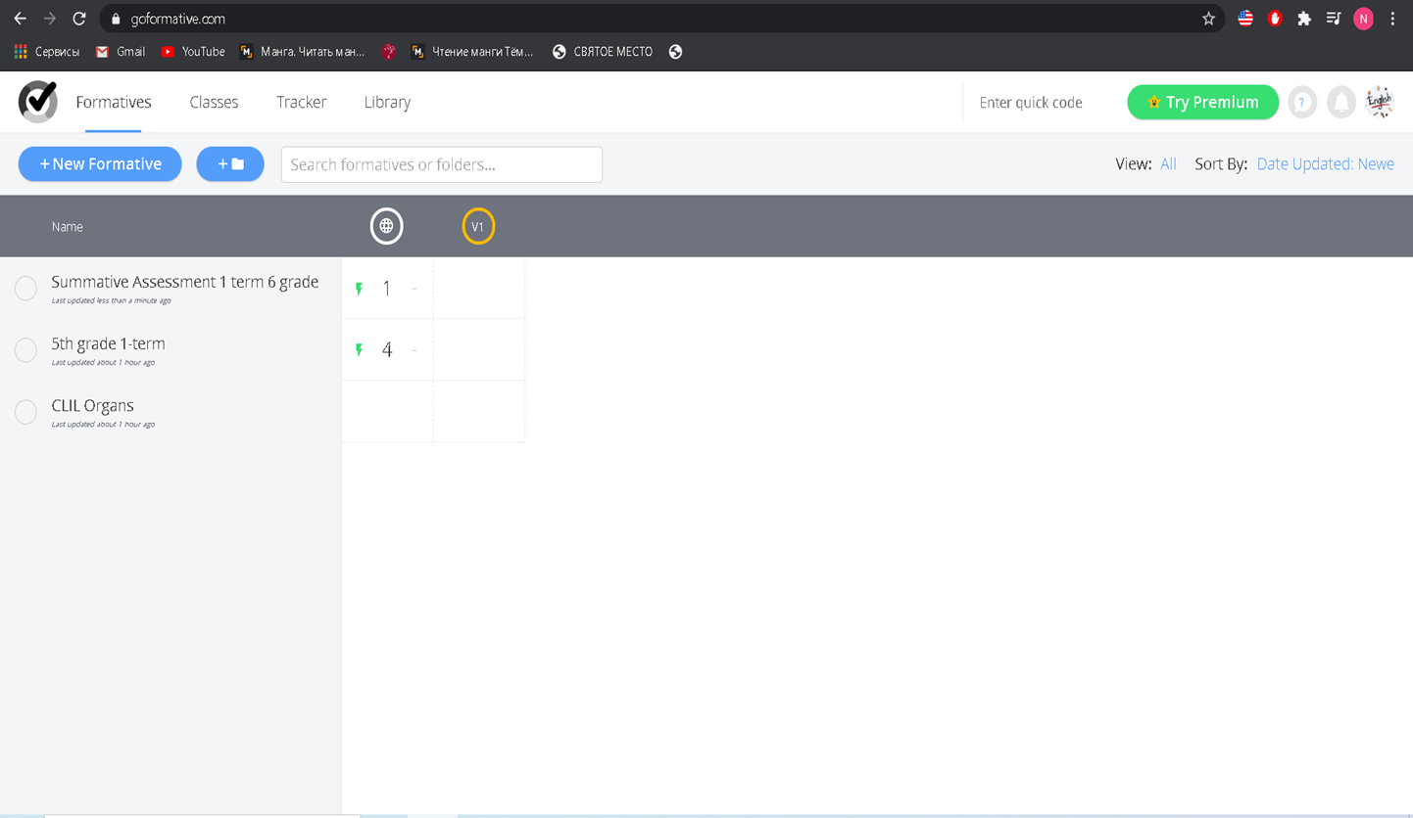
Assessment of learning, those end of the term or year summative or interim assessments, are designed to determine the measure of a student's learning.

Slide 13
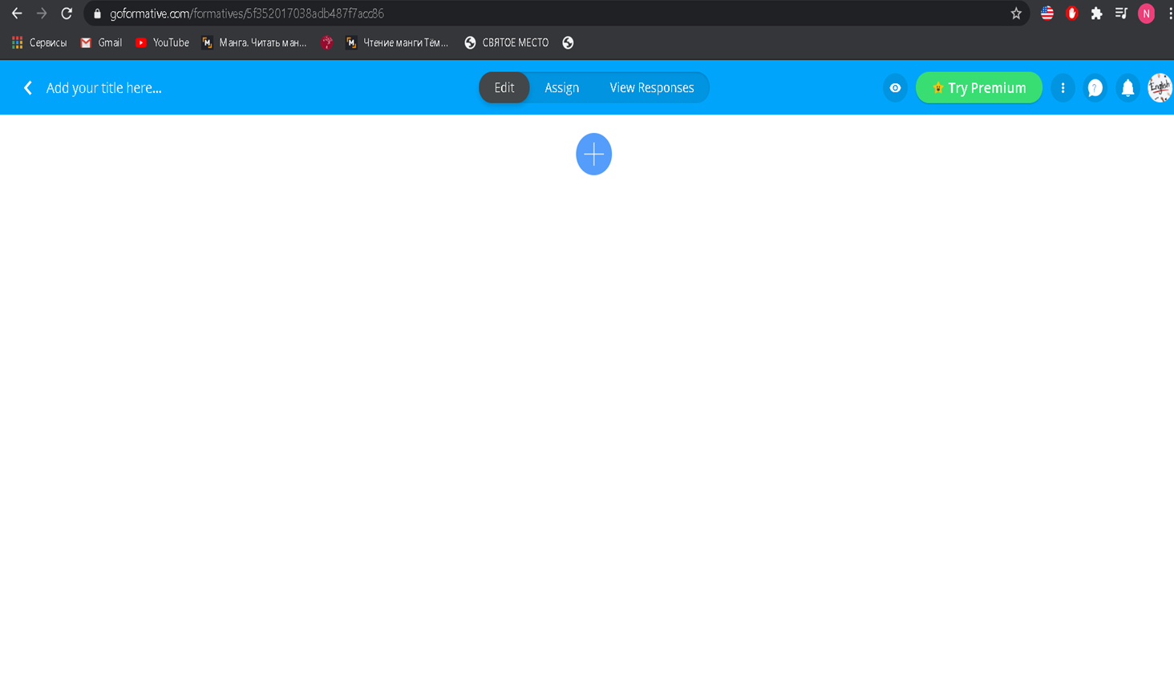


Slide 14
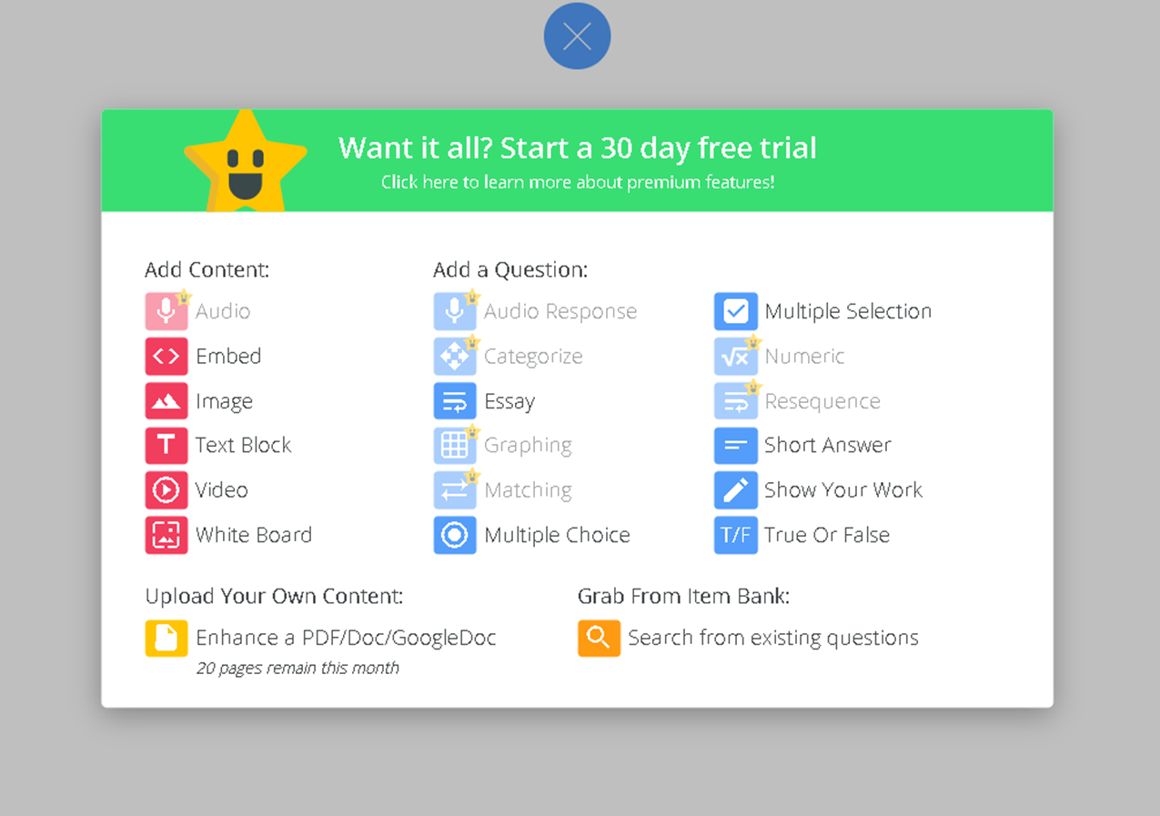

Slide 15
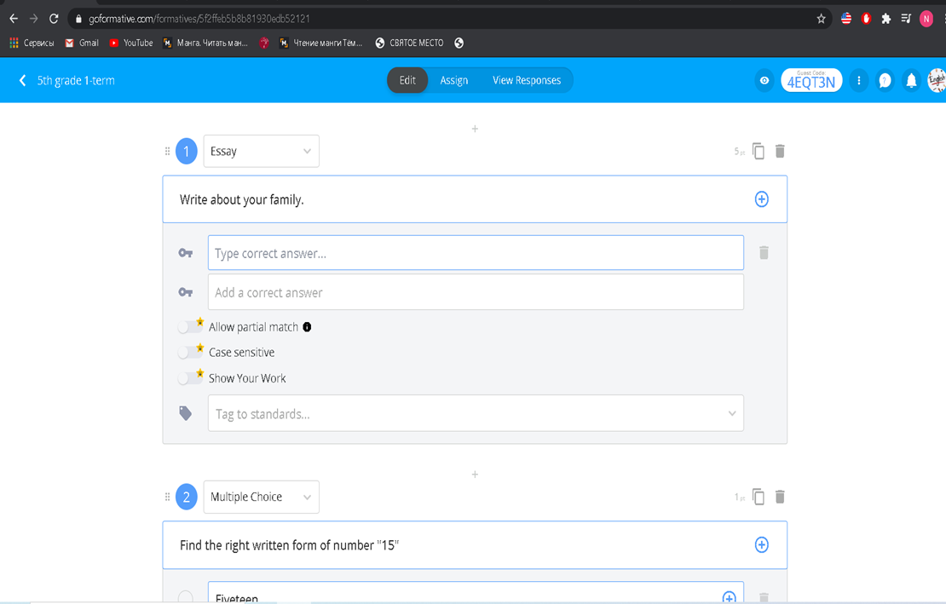
This screenshot gives you a preview of the “editing’ phase when creating your task in Formative.

Slide 16
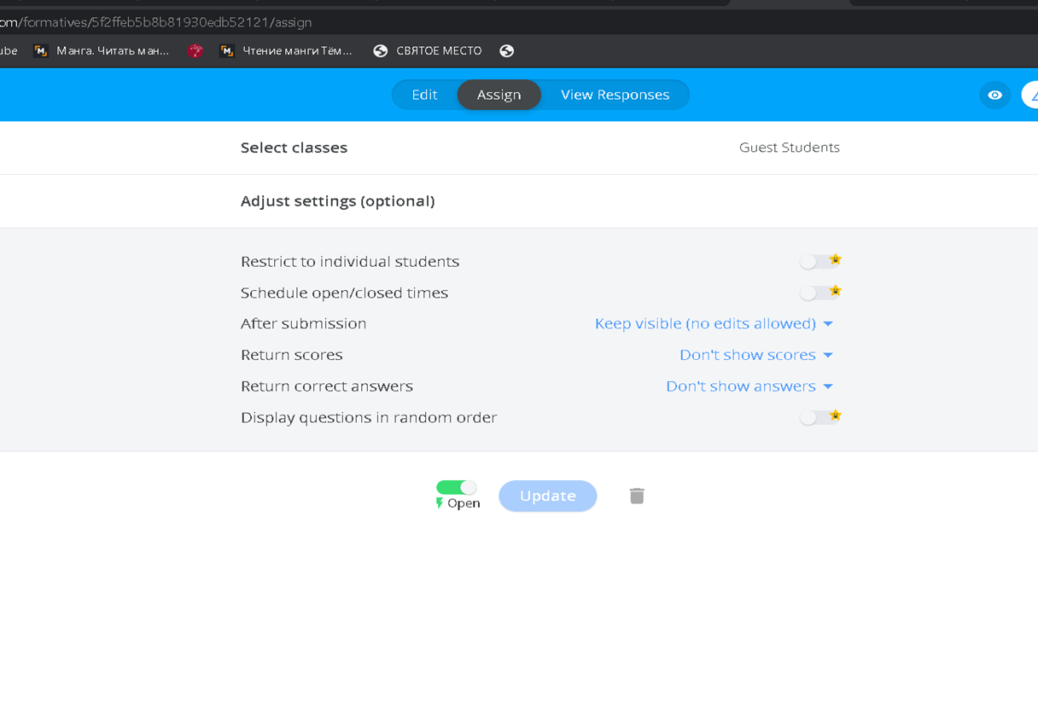
Once your task is created, it can be assigned using the “assign” function of Formative.

Slide 17
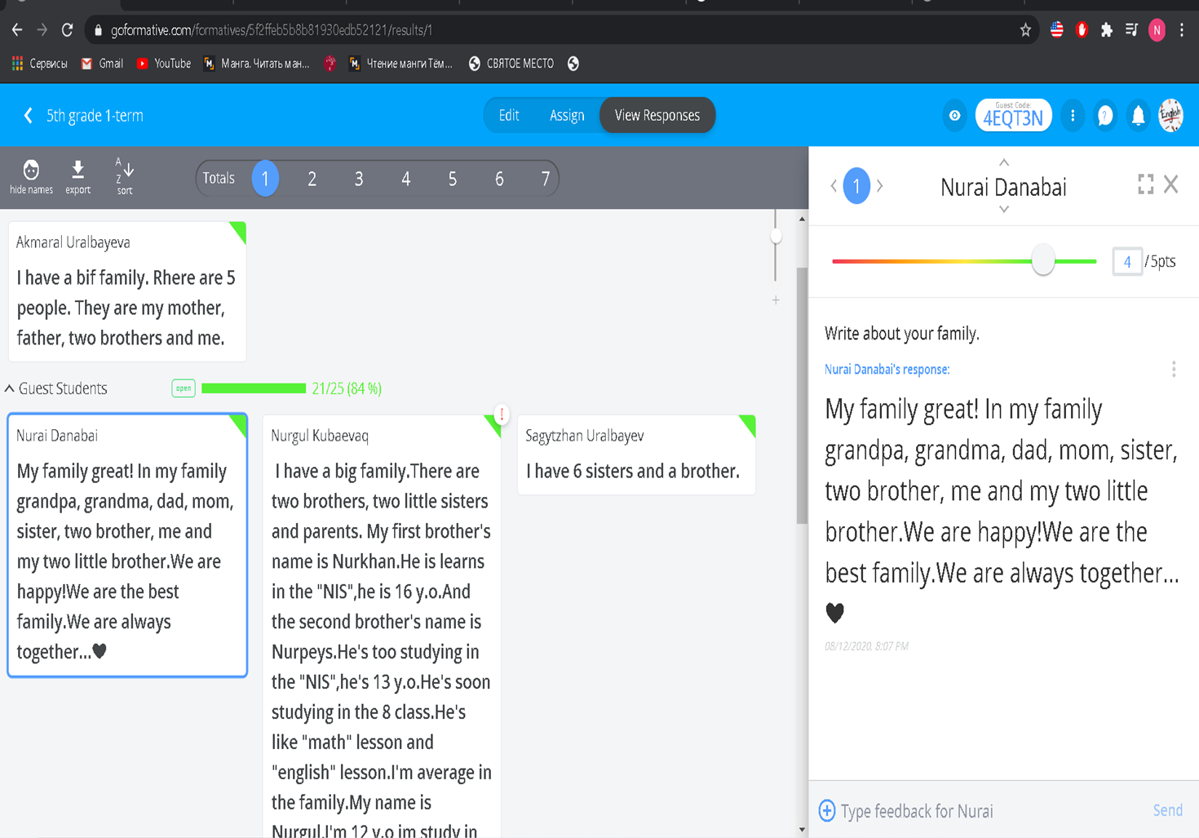

Slide 18
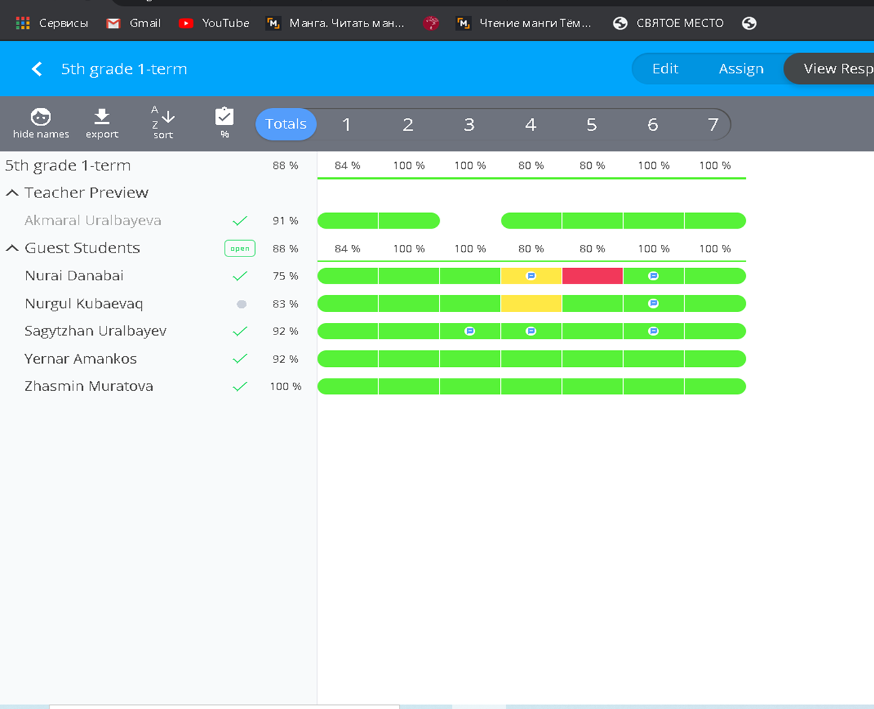
Finally, this screenshot shows captures how student responses are presented in within the Formative Task.

Slide 19
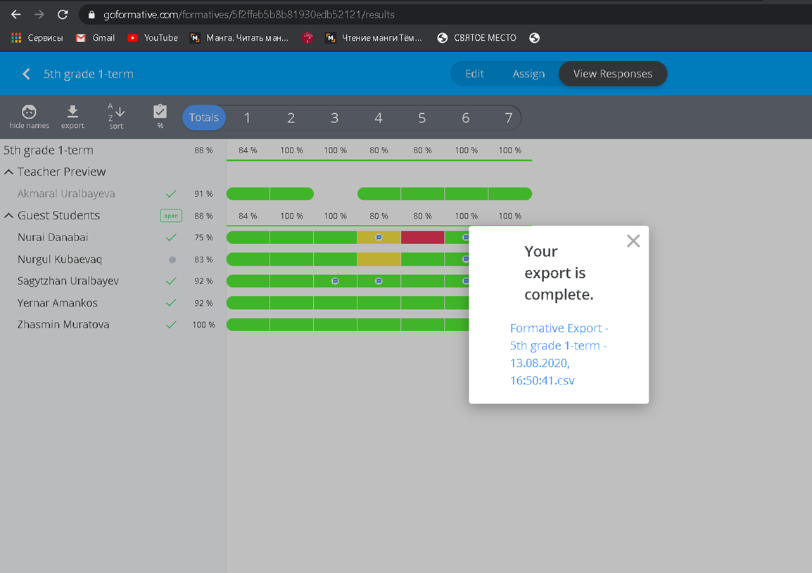

Slide 20
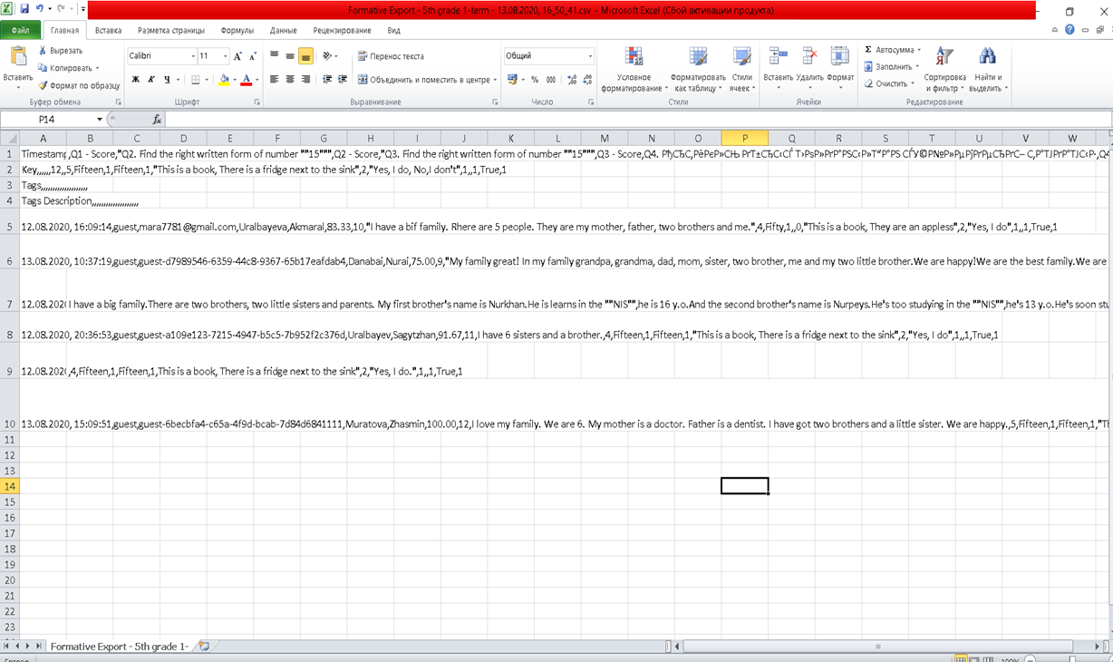
You can download and save students’ assignments in excel format

Slide 21
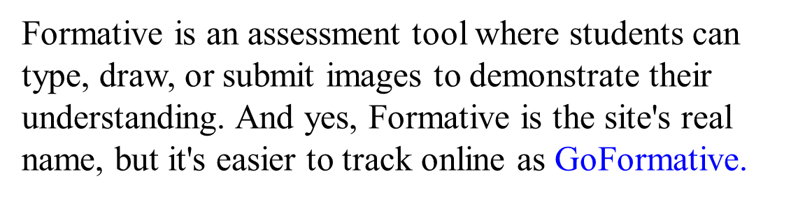

Slide 22
Thank you for your attention !

