Slide 1
The ways to design tasks that encourage development of students’ speaking skills
Aikimbaiyeva N. n.
Aktau. school-21

Slide 2
English
Listening
Speaking
[Grammar]
Reading
[Vocabulary]
Writing
[Pronunciation ]

Slide 3
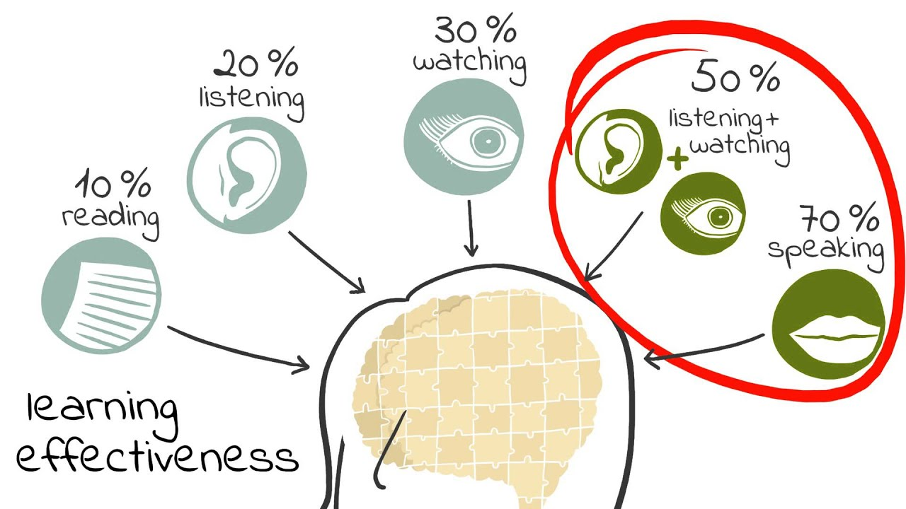

Slide 4
Language learners need to recognize that speaking involves three areas of knowledge:
Mechanics
Functions
Social cultural rules and norms
(pronunciation, grammar, and vocabulary): Using the right words in the right order with the correct pronunciation
(transaction and interaction): Knowing when clarity of message is essential (transaction/information exchange) and when precise understanding is not required (interaction/relationship building)
(turn-taking, rate of speech, length of pauses between speakers, relative roles of participants): Understanding how to take into account who is speaking to whom, in what circumstances, about what, and for what reason.

Slide 5
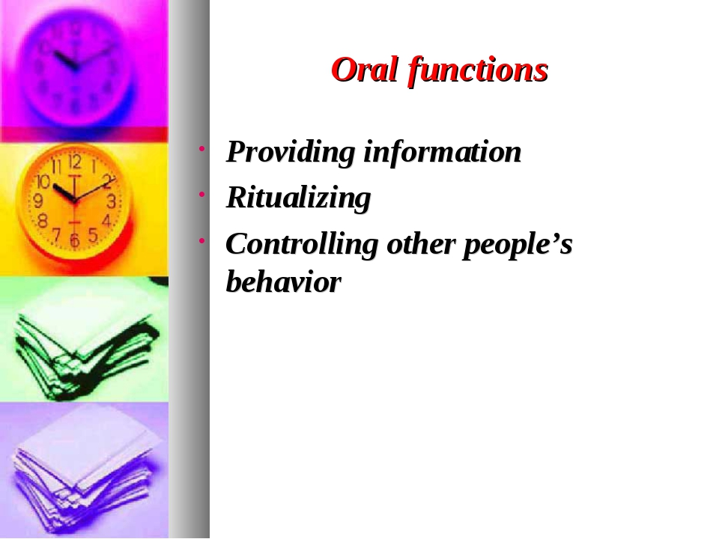

Slide 6
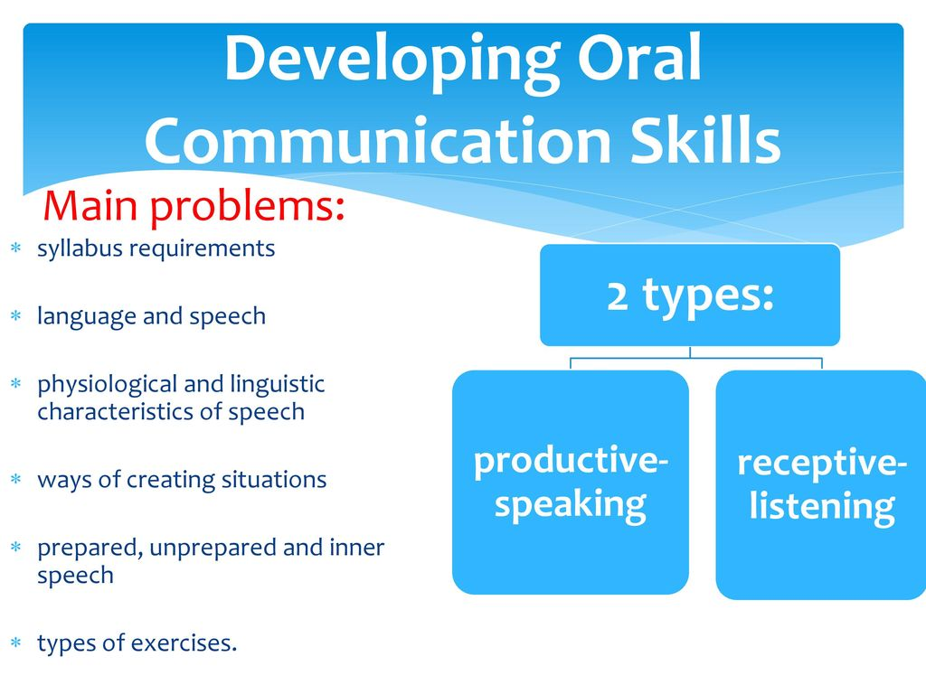

Slide 7
The specific signs of speaking process
  Stimulation.
  Activity.
  Aim-direction.
  Connection with activity.
  Connection with thinking.
  Connection with a person.
  Depending on situations.
  Independence.
  Speed.

Slide 8
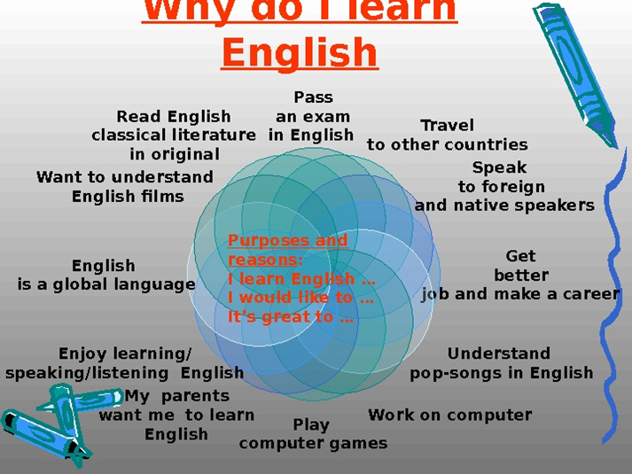
Aims of LT

Slide 9
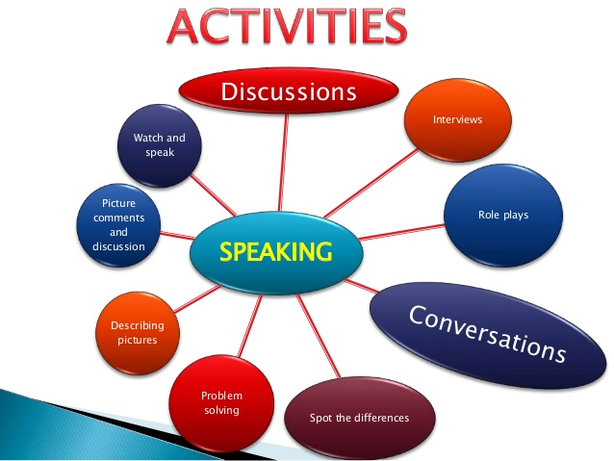

Slide 10
Here are some tips for English language teachers while teaching oral language:
Reduce your TTT (Teacher Talking Time) in the classroom, by giving simple and clear instructions, by asking one or two students to show (by means of speaking) that they understood the task instructions, and also by asking other students to answer a student's question. Being a teacher of English is different from being a lecturer.
Provide maximum opportunity to students to speak the target language by providing a rich environment that contains collaborative work, authentic materials and tasks, and shared knowledge.
Try to involve each student in every speaking activity; Increase STT (Student Talking Time), for this aim, practice different ways of student participation.
Indicate positive signs when commenting on a student's response.
Avoiding yes/no questions; prefer those questions that make students speak in order to make themselves clear. Ask eliciting questions such as "What do you mean? How did you reach that conclusion?" in order to prompt students to speak more.
Provide written feedback like "Your presentation was really great. It was a good job. I really appreciated your efforts in preparing the materials and efficient use of your voice…"
Do not correct students' pronunciation mistakes very often while they are speaking. Correction should not distract student from his or her speech. When your students are having fluency practice (for instance, free conversation), which is totally different from pronunciation or grammar practice, never correct them, unless something really serious happen. Let them talk! Let them feel that they can communicate in despite of their mistakes in pronunciation, grammar etc. Praise them for speaking!!! Show satisfaction!!!
Involve speaking activities not only in class but also out of class; contact parents and other people who can help.
Circulate around classroom to ensure that students are on the right track and see whether they need your help while they work in groups or pairs.
Provide the vocabulary beforehand that students need in speaking activities.
Diagnose problems faced by students who have difficulty in expressing themselves in the target language and provide more opportunities to practice the spoken language.

Slide 11

Conclusion
Each person develops an individual procedure (actually a sequence of procedures) of thinking ability through speaking process, which is the main sign of outlook improvement of comprehensibly developed human being.

